Slide 1

DATA INDEPENDENCE Logical & Physical Independence in DBMS Architecture
Presented by:
BAVANI SRI M(19211405)
CSA0506-Database Management System
Date: 21/07/2026
Technical Presentation

Slide 2
Introduction
What Is Data Independence?
The capacity to change the schema at one level of a database system without having to change the schema at the next higher level.
Why It Matters ?
Isolates application programs from changes in data storage or structure
Reduces maintenance cost when the database evolves
2 Types of Data Independence: Logical & Physical

Slide 3
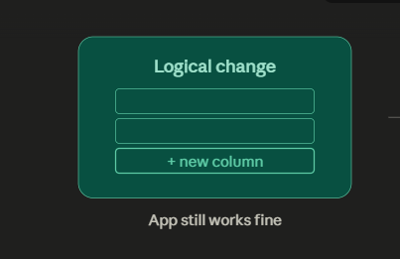
Logical Data Independence
Definition :
The ability to change the conceptual (logical) schema without altering external schemas or application programs.
Example :
Adding a new column (e.g., "Email") to a Student table, or adding an entirely new table, does not require rewriting the existing application queries or reports that use the old schema.
More Difficult to Achieve Because external views and application code are more tightly tied to the logical schema than to physical storage details.

Slide 4
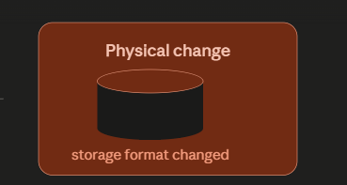
Physical Data Independence
Definition :
The ability to change the internal (physical/storage) schema without altering the conceptual schema.
Example :
Switching a table's storage from a flat file to a B-tree index, or moving data to a different disk / server, does not affect how users or applications query the data.
Easier to Achieve Because the conceptual schema hides low-level storage and access-path details from everything above it.

Slide 5
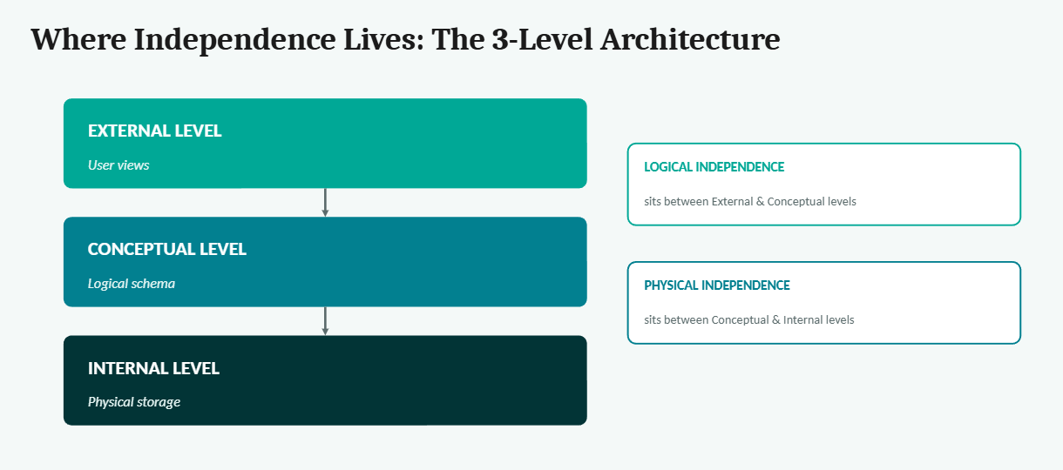
The 3-Level Architecture

Slide 6
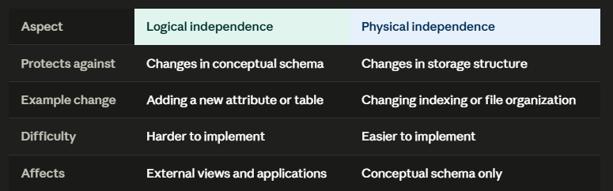
Logical vs Physical Comparison Table.

Slide 7
Significance in DBMS Architecture
Flexibility Schemas can evolve to meet new requirements without breaking existing systems.
Maintainability Reduces cost and risk of maintaining applications as the database grows.
Scalability Storage and structure can be optimized independently as data volume increases.

Slide 8
Conclusion:
Data independence lets us change a schema at one level without affecting the level above it.
Logical independence protects applications from changes to the conceptual schema.
Physical independence protects the schema from changes in storage.
This is what allows real systems, like banking applications, to evolve without disrupting the applications built on top of them.

Slide 9


Thank You!!!

